Slide 1
Analysis of Road Deaths in the U.S. in 2022
Using the Fatality Analysis Reporting System (FARS) 2022 - Accidents
Group 6 Members: Kipras Kairys, Robert Backe, Adriano Onate, and Maxwell Shank

Slide 2
Project Goal
The objective of this project is to analyze the 2022 Fatality Analysis Reporting System (FARS) dataset to identify key factors associated with fatal crashes in the United States and to generate insights that may inform strategies for reducing high-risk driving conditions.

Slide 3
Why this matters?
We’ve all been affected by car accidents in one way or another, whether through our own experiences or those of people we know. Understanding the common factors behind these crashes is crucial, as it allows us to develop better measures to prevent them or reduce their impact.

Slide 4
Dataset Description
The dataset was obtained in the US from Jan. 1, 2022, through Dec. 31, 2022, by the National Highway Traffic Safety Administration to collect data on fatal crashes.
Contains information relating to state, county, city, number of persons involved, month, day, year, hour, minute, street address, route, rural/urban, road owner name, NHS, special jurisdiction, mile point, latitude, longitude, cause of collision, collision direction, light condition, weather, EMS arrival, hospital arrival, and number of fatalities for each entry in the data set.
Dataset Structure: 58 Columns and 39682 Rows
Data Types: String, Int, and Double

Slide 5
1
Descriptive

Slide 6
Descriptive Analysis
What is the total number of fatalities associated with the top 10 most prevalent collision events?
Importance: We can use this analysis to identify the types of collision events most associated with fatal crashes and apply those insights to develop targeted safety measures that help reduce the number of deadly accidents on U.S. roads.

Slide 7
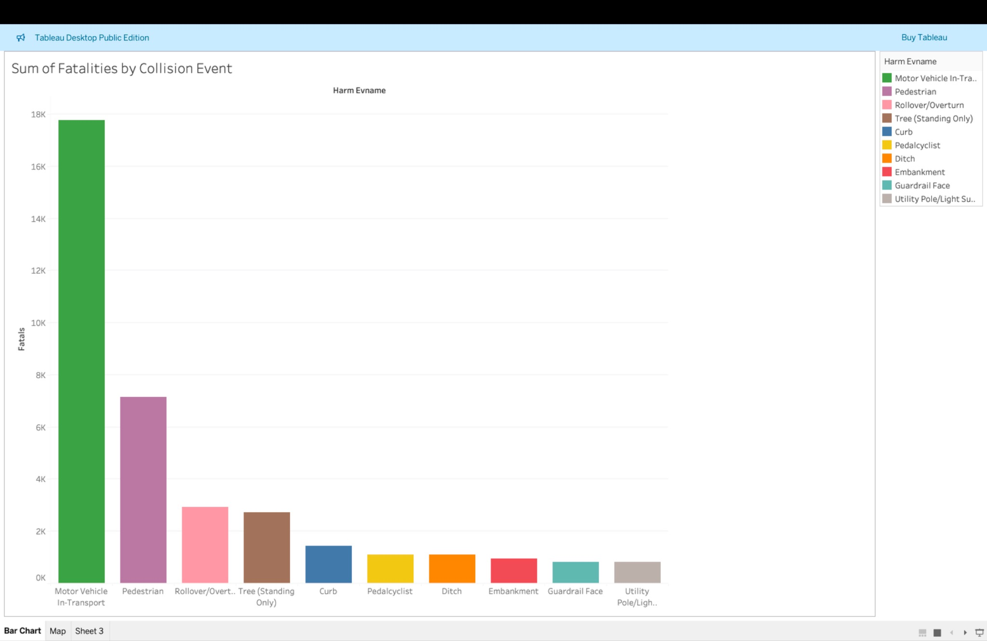
Notes:
Update x and y names

Slide 8
Results
Motor Vehicle in Transport crashes result in far more fatalities than any other event type, followed by Pedestrian and Rollover/Overturn crashes. These findings help identify where targeted safety measures and policy efforts may be most effective in reducing fatal roadway incidents.

Slide 9
Recommendations
Prioritize safety measures for Motor Vehicle in Transport crashes, where fatalities are highest
Strengthen protections for pedestrians through better crosswalks, lighting, and traffic calming
Implement stability and speed-control strategies to reduce rollover/overturn crashes

Slide 10
2
Explanatory

Slide 11
Explanatory Analysis
How do different combinations of lighting and weather relate to fatal crash outcomes?
Importance: Understanding these high-risk conditions is important because it helps transportation and safety agencies target improvements,such as better road lighting, weather alerts, and speed regulations to reduce fatal collisions.

Slide 12
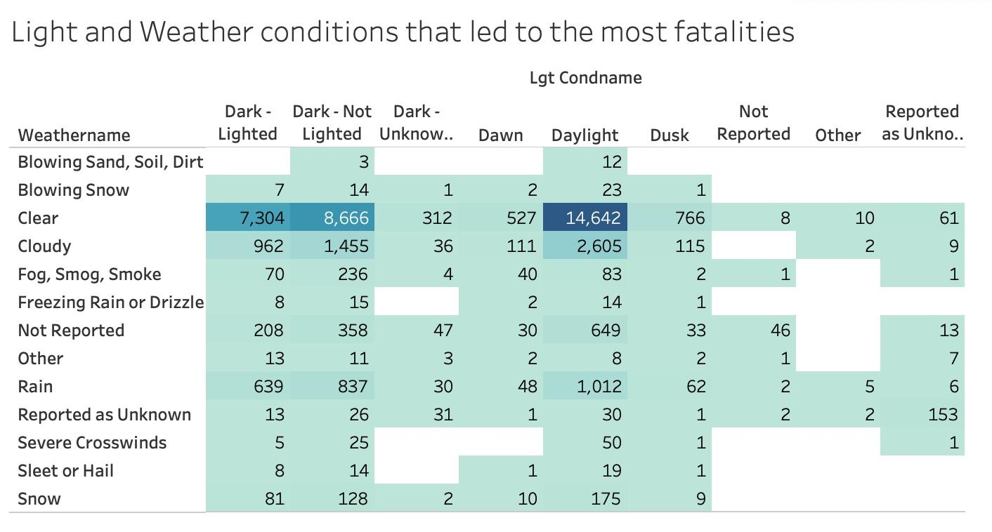
Notes:
Most people are driving during this time, so there may be more casualties in those conditions

Slide 13
Results
The highest fatalities occur during clear weather, especially in daylight and dark, non-lighted conditions. By identifying the environmental conditions linked to the most severe crashes, this analysis can support better road safety planning and prevention efforts.

Slide 14
Recommendations
Improve lighting in dark, non-lit areas
Enhance visibility with better markings and speed controls
Target high-risk zones with focused enforcement and safety measures

Slide 15
Summary
Our analysis of the FARS 2022 data shows that motor-vehicle-in-transport crashes and pedestrian collisions resulted in the highest number of fatalities, making them key targets for safety improvement.
Fatalities were also most common in clear weather and during daylight or dark, non-lighted conditions, which suggests that visibility and driver behavior play a major role in deadly crashes. These insights can help guide roadway design, enforcement, and public safety efforts to reduce the conditions most linked to fatal accidents.

Slide 16
Q&A
Thank you!

